Slide 1
Notes:
Welcome to the 2025 Friends of Scouting training for Transatlantic Council.
Thank you for investing your time today to learn more—and for your commitment to communicate the TAC story and help raise funds vital to "Unparalleled Scouting".
You can see the image of Friends of Scouting in the patch design for those who make a gift of $125 (bronze border), $250 (silver border), or $500 (gold border)

Slide 2
Our Agenda
What is Friends of Scouting (FOS) and why is it important to your TAC Scouting experience
Levels of Giving and Recognition
TAC Operating Budget and how your gift is invested in programs and services
How to make a FOS gift and invite others to invest in Friends of Scouting
Notes:
Our agenda:
What is Friends of Scouting (FOS) and why is it important to your TAC Scouting experience
Levels of Giving and Recognition
TAC Operating Budget and how your gift is invested in programs and services
How to make a FOS gift and invite others to invest in Friends of Scouting

Slide 3
What is Friends of Scouting?
Opportunity to contribute resources to the programs and services delivered by Transatlantic Council
Opportunity to communicate the positive impact of unparalleled Scouting in Transatlantic Council
Notes:
So what is Friends of Scouting?
It is not just about raising funds for Transatlantic Council.
Opportunity to contribute resources to the programs and services by Transatlantic Council.
Opportunity to communicate the positive impact of unparalleled Scouting in Transatlantic Council.

Slide 4
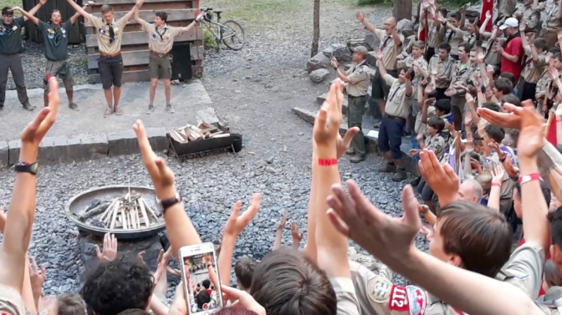
Why is TAC Scouting important to you?
Notes:
Why is TAC Scouting important to you?
What makes it special for you and your family?
Let's hear from you and get your feedback.

Slide 5
What help do you need to deliver unparalleled Scouting in your community?
Notes:
What help do you need to deliver unparalleled Scouting in your community?
What programs and services do you rely on to enrich your TAC Scouting experience?
Let's hear from you.

Slide 6
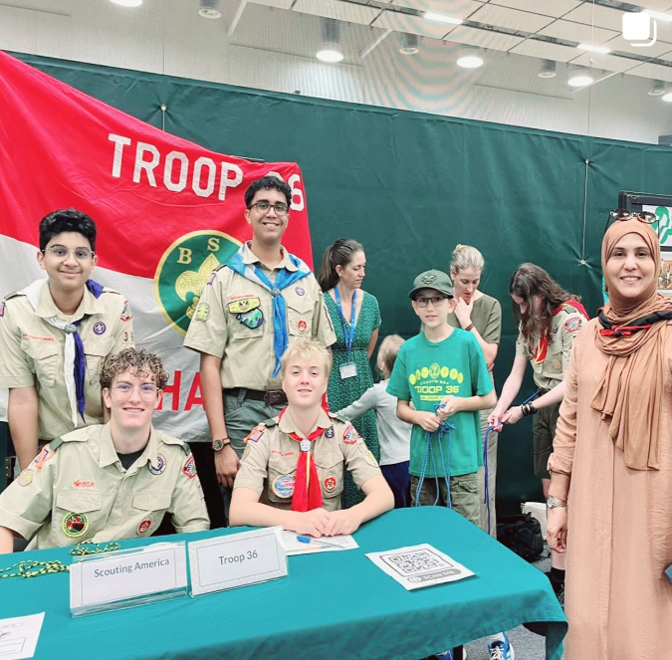
What is the positive impact of TAC Scouting?
4,000+ youth developing their leadership and character
2000+ adults influencing youth of great promise
150+ units in 50 countries
Arrow of Light, Eagle Scout, Summit Award, Quartermaster recognitions
Day Camps, Summer Camps, Merit Badge Weekends, Camporees
Community Service Projects
Historic Trails
Notes:
What is the positive impact of TAC Scouting?
4,000+ youth developing their leadership and character
2000+ adults influencing youth of great promise
150+ units in 50 countries
Arrow of Light, Eagle Scout, Summit Award, Quartermaster recognitions
Day Camps, Summer Camps, Merit Badge Weekends, Camporees
Community Service Projects
Historic Trails

Slide 7
TAC Eagle Scout Projects
Bike Park Reclamation
High School Gardens
Refugees on Wheels
Orphans Home Shoe Drive
Hands-on CPR Marathon
Toy Drive for Refugees
Refugee Center
Building Bat Houses
5K for Autism Awareness
Notes:
You cannot overlook the positive impact of TAC Eagle Scout projects.
Here are some examples.
Bike Park Reclamation
High School Gardens
Refugees on Wheels
Orphans Home Shoe Drive
Hands-on CPR Marathon
Toy Drive for Refugees
Refugee Center
Building Bat Houses
5K for Autism Awareness
What other Eagle Scout projects have you experienced or heard about?

Slide 8
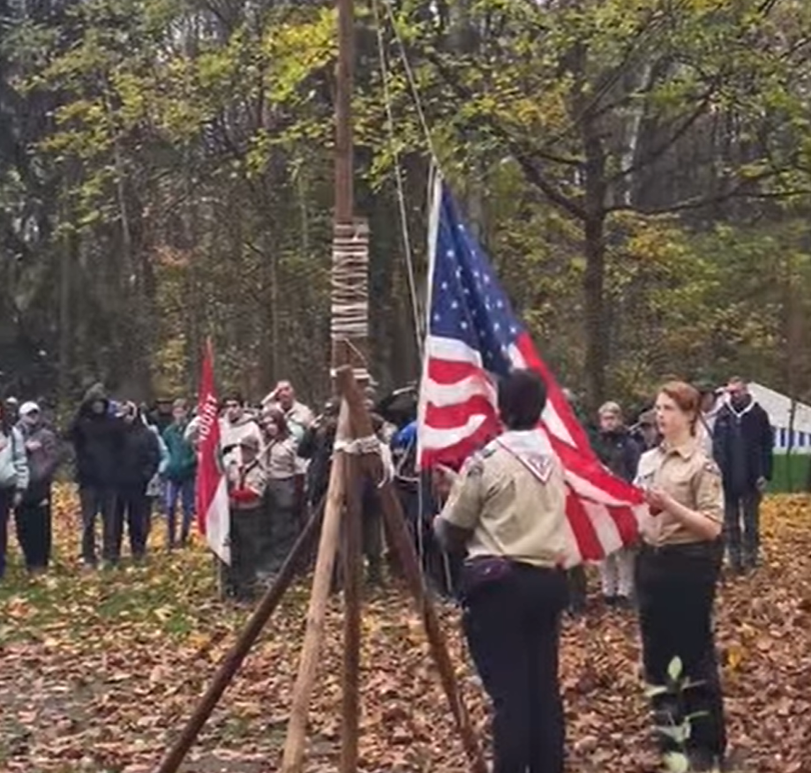
Why invest in TAC Scouting?
Unparalleled Scouting for more youth
Exciting camp programs
More trained volunteers and youth
Stronger support to TAC Communities
More packs, troops, crews, ships
Develop leaders and citizens
Instill values of Scout Oath and Law
Notes:
Why invest in TAC Scouting?
Unparalleled Scouting for more youth
Exciting camp programs
More trained volunteers and youth
Stronger support to TAC Communities
More packs, troops, crews, ships
Develop leaders and citizens
Instill values of Scout Oath and Law

Slide 9
2025 FOS Goal--$225,000 by 28 February 2025 ​
Goal is ambitious and achievable. ​
High engagement from board members is critical.​
Will require outreach to NEW donors.​
Will require strong support from district and unit leaders.
Notes:
Goal of $225,000 by 28 February 2025​
Goal is ambitious and achievable. ​
High engagement from board members is critical.​
Will require outreach to NEW donors.​
Will require strong support district and unit leaders.

Slide 10
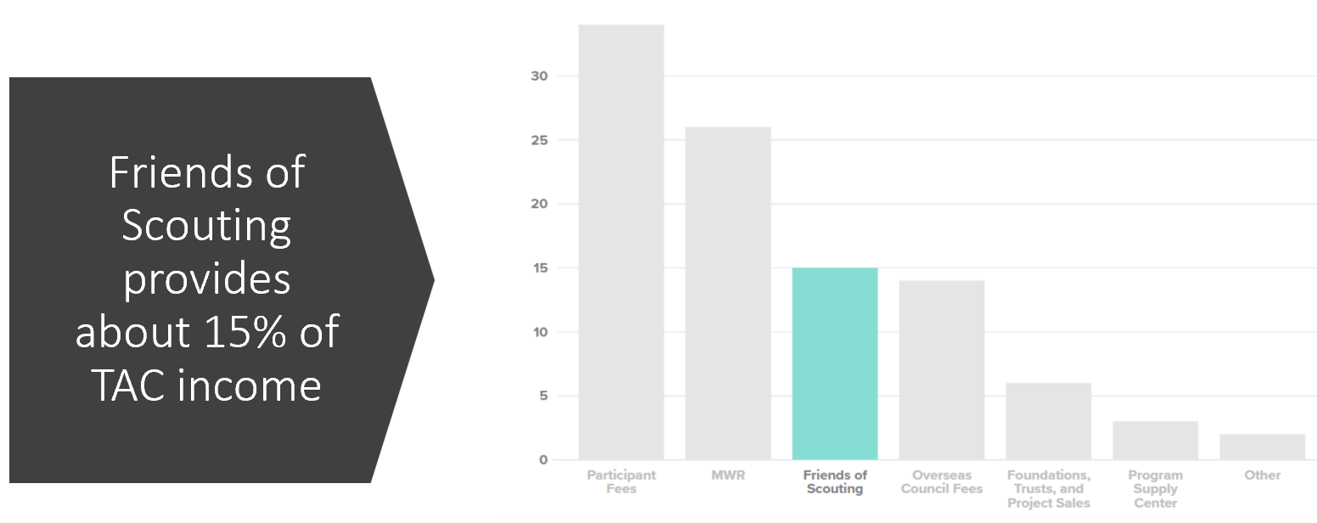
Notes:
TAC Friends of Scouting provides about 15% of TAC revenue.
The TAC budget is heavily focused on program (90.37%)--with modest investments in administration (6.56%) and fundraising (3.07%).
These percentages come from a time study that the TAC staff does to determine how they spend their time.
Most of that time is spent on delivering programs and services to TAC Scouting communities and volunteers.

Slide 11
How TAC Spends its Funds
People—Salaries and Travel
Full Time Staff in Belgium, Germany, Pennsylvania
Seasonal Scout Camp Staff in Switzerland, Croatia, Kenya
Stuff—Programs and Services
Insurance (Accident/Sickness and Liability), Safe Scouting
Patches, Program Supply, Recognitions, Trainings, Conferences, Roundtables
TAC Connection, Website, Social Media, New Unit Organization, Scout Recruitment
Notes:
How TAC spends its Funds. It's on people and on stuff.
People—Salaries and Travel
Full Time Staff in Belgium, Germany, Pennsylvania
Seasonal Scout Camp Staff in Switzerland, Croatia, Kenya
Stuff—Programs and Services
Insurance (Accident/Sickness and Liability), Safe Scouting
Patches, Program Supply, Recognitions, Trainings, Conferences, Roundtables
TAC Connection, Website, Social Media, New Unit Organization, Scout Recruitment

Slide 12
FOS Giving Levels and Recognition​​
$2000 ($200/month) – 8 Scouts Level​--TAC Yeti Water Bottle + FOS Neckerchief + FOS gold patch
$1000 ($100/month) – 4 Scouts Level​--FOS Neckerchief + FOS gold patch
$500 ($50/month) – 2 Scouts Level​--FOS gold border patch
$250 ($25/month) – 1 Scouts Level​--FOS silver border patch
$125 ($12.50/month) – “Scout Me In” Level​--FOS bronze border patch
Notes:
FOS Giving Levels and Recognition
$2000 ($200/month) – 8 Scouts Level​--TAC Water Bottle + FOS Neckerchief + FOS gold patch
$1000 ($100/month) – 4 Scouts Level​--FOS Neckerchief + FOS gold patch
$500 ($50/month) – 2 Scouts Level​--FOS gold patch
$250 ($25/month) – 1 Scouts Level​--FOS silver patch
$125 ($12.50/month) – “Scout Me In” Level​--FOS bronze patch

Slide 13
Friends of Scouting (FOS) Volunteer Recognition
Confirm 5 Friends of Scouting gifts (not including your own FOS gift) from 1 November 2024 through 28 February 2025
Receive a special FOS patch with our appreciation.
Notes:
Friends of Scouting (FOS) Volunteer Recognition.
Confirm 5 Friends of Scouting gifts (not including your own FOS gift)
From 1 November 2024 through 28 February 2025
Receive a special FOS patch with our appreciation.

Slide 14
IC5+ means that I "see" or "C" five or more individuals and invite them to give to TAC Friends of Scouting
Notes:
IC5+ means that I "see" or "C" five or more individuals and invite them to give to TAC Friends of Scouting.
So you want to recruit, train, and guide enough volunteers so that you have "teams of 5" being approached by a volunteer who will make their own Friends of Scouting gift and invite 5 others to give as well.
In this sample chart, pay attention to the following:
Volunteer captains names are in bold font—with the team of 5+ volunteers they will approach for a Friends of Scouting gift
When individuals make their gift, we will highlight their name in green
We will share this report with you each week—to drive recognition, appreciation, and action

Slide 15
Who can you invite to give to TAC Friends of Scouting?
Friends of Scouting donors (current and former)
Wood Badge staffers and participants
Silver Beaver, Award of Merit, and TAC Patch recipients
Experienced unit volunteers
Eagle Scouts of all ages
TAC Alumni
Executive Board and Council Committee members
District and Unit Volunteers
Notes:
Who can you invite to give to TAC Friends of Scouting?
Friends of Scouting donors (current and former)
Wood Badge staffers and participants
Silver Beaver, Award of Merit, and TAC Patch recipients
Experienced unit volunteers
Eagle Scouts of all ages
TAC Alumni
Executive Board and Council Committee members
District and Unit Volunteers

Slide 16
Friends of Scouting Training
Monday 18 November ​or Tuesday 19 November 2024​
1200 New York time, 1700 London time, 1800 Brussels time
You only need to attend one session.
https://teams.microsoft.com/l/meetup-join/19%3ameeting_NmEyNTBlMDMtM2U1YS00YjY4LTkzMGQtYjE2M2VkMzY3MDNk%40thread.v2/0?context=%7b%22Tid%22%3a%22fd9008a0-7846-4989-a4c5-77cfad3f7e4e%22%2c%22Oid%22%3a%22d68a0e55-e6c1-4808-9bc2-0b0d48b880a0%22%7d
Notes:
Friends of Scouting Training ​
Monday 18 November ​or Tuesday 19 November ​2024
1200 New York time, 1700 London time, 1800 Brussels time
You only need to attend one session.
https://teams.microsoft.com/l/meetup-join/19%3ameeting_NmEyNTBlMDMtM2U1YS00YjY4LTkzMGQtYjE2M2VkMzY3MDNk%40thread.v2/0?context=%7b%22Tid%22%3a%22fd9008a0-7846-4989-a4c5-77cfad3f7e4e%22%2c%22Oid%22%3a%22d68a0e55-e6c1-4808-9bc2-0b0d48b880a0%22%7d

Slide 17
Friends of Scouting Report Meetings ​
All IC5+ Volunteers are encouraged to attend.​
Wednesdays
1200 New York time, 1700 London time, 1800 Brussels time​
4 and 18 December​ 2024
8 and 22 January 2025 ​
5 and 19 February 2025 ​
5 March 2025—FOS Celebration​
Notes:
Friends of Scouting Report Meetings
All IC5 Volunteers are encouraged to attend.​
Wednesdays
1200 New York time, 1700 London time, 1800 Brussels time ​
4 and 18 December​ 2024
8 and 22 January 2025 ​
5 and 19 February 2025 ​
5 March 2025—FOS Celebration​

Slide 18
Notes:
To be prepared to invite others to invest in TAC Scouting, it’s helpful to know what are the giving motivators for donors.
Confidence
Clarity
Value
Personal connection
Visible impact
Gratitude

Slide 19
Notes:
Here are some examples of Giving motivators

Slide 20
Direct FOS Invitation --Face to Face --Zoom --Phone Call ​
Notes:
The most effective way to invite a donor to give is a direct invitation.
Face to Face
Zoom
Phone Call

Slide 21
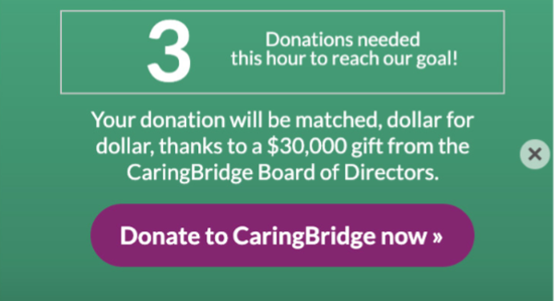
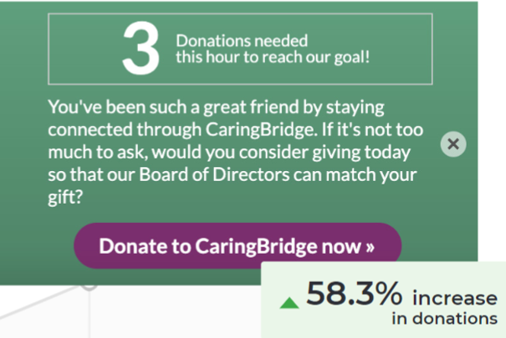
When inviting donors to give, Words Matter. See the updated words on the right side!
Notes:
When inviting donors to give, Words Matter. See the updated words on the right side!
CaringBridge was running a two-day match in the month of December as part of their year end campaign.
They wondered if more “communal language” that affirmed the donor in their relationship to CaringBridge
and made a less direct ask would be more effective at getting people to enter the donation funnel.
They drafted a treatment that made some key shifts.
First, it began by talking about the donor themselves—”You’ve been such a great friend by staying engaged through CaringBridge.
Then, it softened the ask by starting with “If it’s not too much to ask”, which gives the donor a sort of “release valve” from the pressure of “donate now”.
Finally, the matching gift from the Board of Directors was positioned as an opportunity or service offering provided to the donor rather than something they were expected to respond to.

Slide 22
5 Steps to an Effective FOS Invitation via Email
Introduce yourself
Explain how Scouting changed you
Tell what you learned in Scouting
Conclude that “Because of Scouting…”
Then share the invitation to give
Notes:
5 Steps to an Effective FOS Invitation via Email
Introduce yourself
Explain how Scouting changed you
Tell what you learned in Scouting
Conclude that “Because of Scouting…”
Then share the invitation to give

Slide 23
1. Introduce yourself
Hello, this is Dan Coberly. I serve as Council President for Transatlantic Council.
In the early 1960’s as a young preteen in the U.S. Panama Canal Zone, I reached the first fork in the road of my young life. I was being pressured to join a gang.
My father, like many others, was a Special Forces Soldier deployed on many far-away missions. He simply wasn’t there to guide me. My mother was a French-Italian WWII war bride, still learning to speak English. Life was chaos, without stability, moving around the world, always worried that my father would not come home.

Slide 24
2. Explain how Scouting changed you
That day, one of my friends invited me to join what he called a “good gang”—Scouting. I went to my first meeting and I was hooked. Suddenly, I belonged to something. There was a plan, a structure, fun and fellowship, standards that were completely up to me to meet. And many unselfish leaders became my role models.
Scouting brought a touch of America to us living overseas. That was important because I hardly lived in the States. Scouting was the one constant in my life, no matter where we lived throughout the world. Unlike sports or clubs or other activities, in Scouting, I didn't have to start over whenever we moved. I could continue on the trail to Eagle.
And I made friends instantly!

Slide 25
3. Tell what you learned in Scouting
What I learned in Scouting about myself and other people is more valuable than all the degrees I have since earned. I gained self-confidence and life-long skills as an Eagle Scout in Troop 62 in Wurzburg, Germany. I learned how to be a good leader, a good follower, and how to make intelligent choices.
Since then, I’ve been blessed to meet and work with famous leaders, Kings and Queens and Astronauts, senior cabinet officials, Supreme Allied Commanders…all of whom were Scouts.

Slide 26
4. Conclude that “Because of Scouting…”
Because of Scouting, I attained the highest enlisted rank in the military, completed many college degrees, was directly commissioned as an officer, became a Distinguished Eagle Scout (back in TAC), was inducted in the US Army Public Affairs Hall of Fame, and earned many awards for distinguished leadership and community service.
Thank God that because of people like you, Scouting offered me a choice that day and every day. It could have been a much different story.

Slide 27
5. Then share the invitation to give
That's why I'm inviting you to please make a generous gift to TAC Friends of Scouting. You can be assured that your support will make a huge difference for youths who need it most!
Please use this link to donate now:
https://donations.scouting.org/#/council/802/appeal/7948
Feel free to call or write me if you have any questions.
THANK YOU on behalf of all TAC Scouts and Scouters!
Dan Coberly

Slide 28
In your email,
use the
first name of
the donor!
Notes:
Email. Use the first name of the donor!
The quickest way to let your donor know that you don’t actually know them is by starting your email with “Dear friend.”
Nearly every email tool on the market today allows you to insert the recipients first name.
And as it turns out, when you call donors by their name, your email performance improves. I
This nonprofit wondered if they could improve their email response by calling the donor by their first name.
Personalizing the email by calling the donor by their name led to a 270% increase in clicks.

Slide 29
In your email,
personalize your
fundraising pitch!
Notes:
Email. Personalization is more than just inserting a first name here and there.
It’s about making the entire email feel personal to the recipient – as if you sat down and wrote an email specifically to them.
This includes personal sender names, subject lines, and copy.
This nonprofit wondered if they could increase email results by making the whole email feel more personal.
Making the email feel more personal led to a 137% increase in clicks.

Slide 30
WhatsApp Invitation to Give
Mary,
You are part of Transatlantic Council (TAC). Your help is needed, please, to ensure a strong TAC Scouting program for 2025.
You can help support TAC’s annual Friends of Scouting appeal, which ends on 28 February 2025.
TAC spends around $250 per year to support each Scout but receives only $48 per Scout at registration. You can help support all of our own Scouts – and many more Scouts--so that TAC can help to serve less-fortunate families.
Please take 3 minutes now to invest in TAC Scouting here:
https://donations.scouting.org/#/council/802/appeal/7948
Notes:
WhatsApp Invitation to Give
Mary,
You are part of Transatlantic Council (TAC). Your help is needed, please, to ensure a strong TAC Scouting program for 2025.
You can help support TAC’s annual Friends of Scouting fundraising appeal, which ends on 28 February 2025.
TAC spends around $250 per year to support each Scout but receives only $48 per Scout at registration. You can help support all of our own Scouts – and many more Scouts so that TAC can afford to serve less-fortunate families.
Please take 3 minutes now to invest in TAC Scouting here:
https://donations.scouting.org/#/council/802/appeal/7948

Slide 31
...because of your Friends of Scouting gift, you deliver "Unparalleled Scouting”
Cub Scout recognition with free pinewood derby cars
Scouts needing help can request and receive camperships
Klondike, Normandy Camporee, Camp Avantura BSA,
Camp Alpine, Camp Kenya
Scout-a-thon—all profits stay with units and free prizes for Scouts
Registered Volunteers have strong liability insurance protection
TAC Connection e-newsletter and TAC social media
TAC Staff help daily with answers, solutions, help, advancement, program, recruitment, camps, and much more
Notes:
Communicate your key messages about Friends of Scouting.
Just say that "...because of your Friends of Scouting gift, you deliver Unparalleled Scouting.
Your gift makes these things possible:
Cub Scout recognition with free pinewood derby cars or Scout sporks
Scouts needing help can request and receive camperships
Klondike, Normandy Camporee, Camp Avantura BSA,
Camp Alpine, Camp Kenya
Scout-a-thon—all profits stay with units and free prizes for Scouts
Registered Volunteers have strong liability insurance protection
TAC Connection e-newsletter and TAC social media
TAC Staff help daily with answers, solutions, help, advancement, program, recruitment, camps, and much more

Slide 32
https://tac-bsa.org/donate/fos/
Notes:
So how do you make your gift to Friends of Scouting?
Where do you direct your volunteers to make their Friends of Scouting gift?
Go to the TAC webpage https://tac-bsa.org/donate/fos/
This is where we keep all the information needed to understand the Friends of Scouting program.
After reviewing all the resources, click the “Give Now!” button

Slide 33
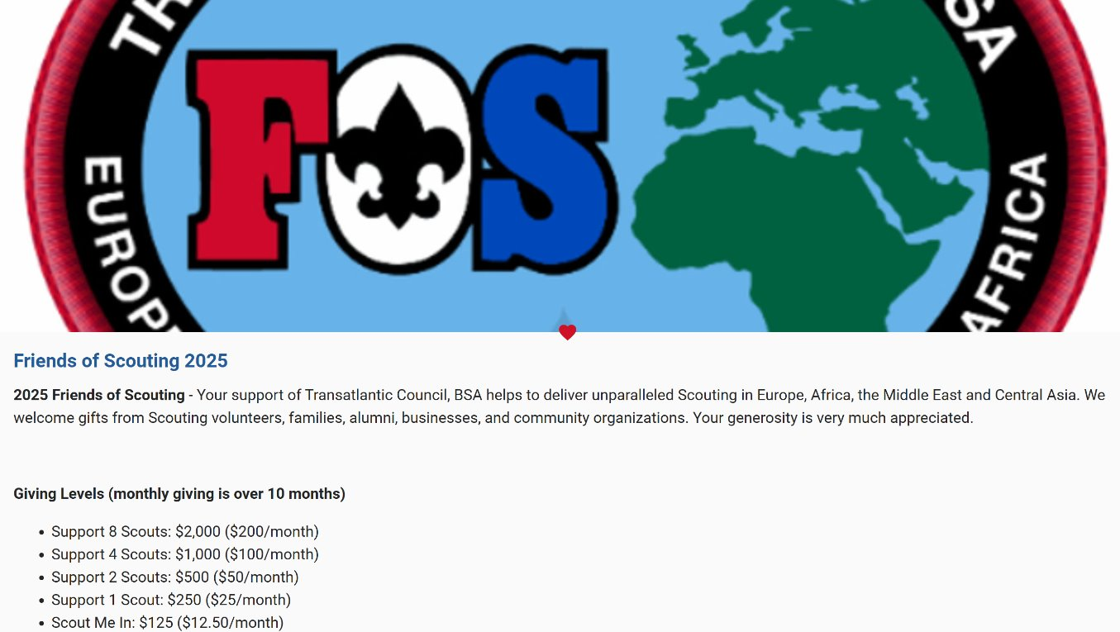
Notes:
After you click the “Give Now!” button,
you arrive at this page where the 2025 Friends of Scouting online giving portal is located.

Slide 34
$1000 FOS Gift--One-time
Notes:
Scroll down on this page and first indicate the gift that you would like to make.
Here is an example of a One-time gift of $1000.
Select One-time
Type in gift amount of 1000
Be sure to not type in any $$ signs. Just type in the number.

Slide 35
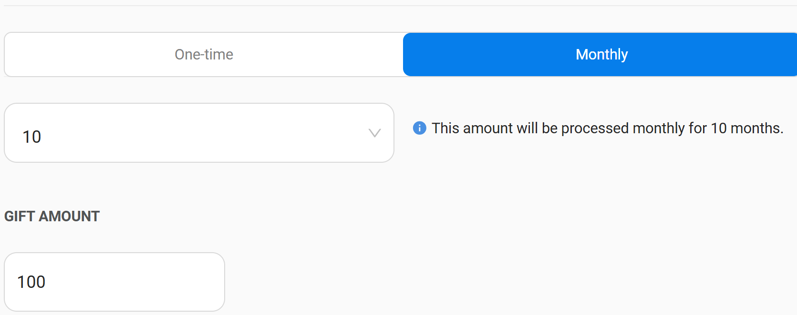
$1000 FOS Gift—Monthly ($100)
Notes:
Or here is an example of a monthly gift of $100.
Select Monthly
It will default to 10 months of giving.
Type in gift amount of 100
Be sure to not type in any $$ signs. Just type in the number.

Slide 36
Information—Personal, Additional, Employer Match
Notes:
Next, type in personal information—first name, last name, email, phone number (and business name if you like)
Under additional information, you can list your district and your unit if you like.
And list any employer gift match information if you can. If this feature does not work for you, please encourage your donors to reach out to the TAC staff for help.
TAC receives many funds each year in matching gifts—and searching for this info is most helpful.

Slide 37
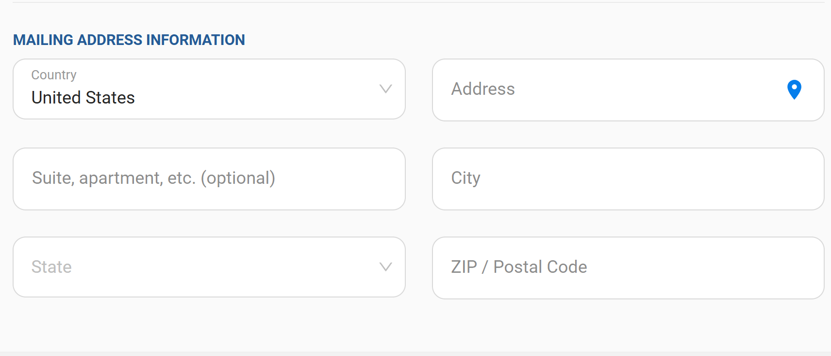
Mailing Address Information
Notes:
You will also add your mailing address.

Slide 38
Payment information
Notes:
Then indicate your credit card information. We accept VISA, MasterCard, American Express, or JCB.
Or you can provide a US bank account information.
Be sure that you check the box if your billing address is the same as the address above.
Or uncheck that box and type in the billing address for your credit card.
Note that you can check the box: Maximize my gift’s impact and pay transaction fees.
Remember that TAC is trying to reach our overall Friends of Scouting goal by the end of February 2025.
One time pledges can be made before 28 February 2025 and paid after that date.
Monthly giving that will include payments made past 28 February 2025 is ok too.

Slide 39
$1030 FOS Gift ($100 monthly over 10 months)
Notes:
Here is an example of a gift of $1000 that is going to be made by giving $100 over 10 months.
In this example, the donor choose to pay the credit card transaction fees—so the total gift is $1030.

Slide 40
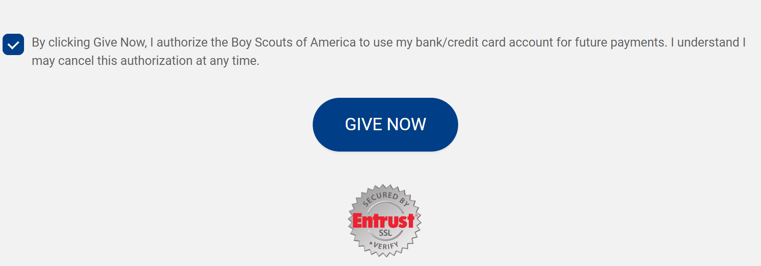
Be sure to check the box AND hit “Give Now” button
Notes:
To process your gift, you must do 2 things!
Check the "By clicking Give Now..." box
Select the "Give Now" button

Slide 41
FOS Resources www.tac-bsa.org/donate/fos
Notes:
There are Friends of Scouting resources on the TAC website to help you.
This FOS presentation will also be available on this website.
www.tac-bsa.org/donate/fos
Friends of Scouting Resources
Friends of Scouting Questions and Answers
Friends of Scouting Email to Executive Board and Advisory Council Members
Friends of Scouting Asks to Volunteers and Parents
FOS Volunteer Training.ppt
FOS Volunteer Training video
TAC Highlights 2020
TAC Highlights 2021
TAC Highlights 2022
TAC Highlights 2023
Friends of Scouting Promotional Video

