Slide 1
TAC Friends of Scouting 2023
Notes:
Welcome to the 2023 Friends of Scouting training for Transatlantic Council.
Thank you for investing your time today to learn more—and for your commitment to communicate the TAC story and help raise funds vital to "Unparalleled Scouting".
You can see the image of Friends of Scouting in the patch design for those who make a "Scout Me In" gift of $125.

Slide 2
Our Agenda Topics
What is Friends of Scouting (FOS) and why is it important to your TAC Scouting experience
Levels of Giving and Recognition
TAC Operating Budget and how your gift is invested in programs and services
How to make a FOS gift and invite others to invest in Friends of Scouting
Notes:
Our agenda topics:
What is Friends of Scouting (FOS) and why is it important to your TAC Scouting experience
Levels of Giving and Recognition
TAC Operating Budget and how your gift is invested in programs and services
How to make a FOS gift and invite others to invest in Friends of Scouting

Slide 3
What is Friends of Scouting?
Opportunity to contribute resources to the programs and services delivered by Transatlantic Council
Opportunity to communicate the positive impact of unparalleled Scouting in Transatlantic Council
Notes:
So what is Friends of Scouting?
It is not just about raising funds for Transatlantic Council.
Opportunity to contribute resources to the programs and services by Transatlantic Council.
Opportunity to communicate the positive impact of unparalleled Scouting in Transatlantic Council.

Slide 4
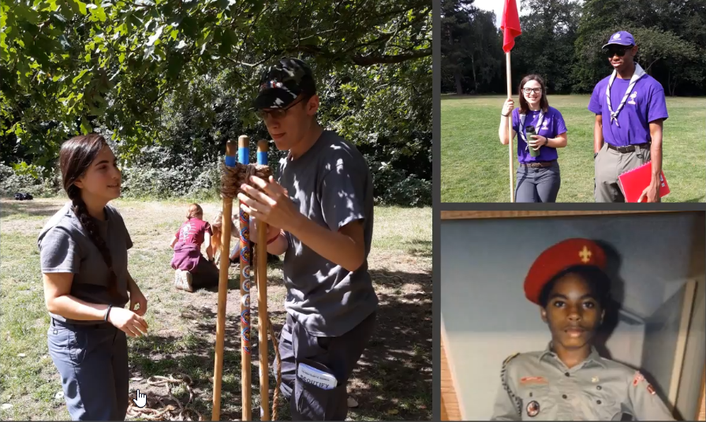
Why is TAC Scouting important to you?
Notes:
So let's hear from you and get your feedback.
Why is TAC Scouting important to you?
What makes it special for you and your family?

Slide 5
What help do you get or need to deliver unparalleled Scouting in your community?
Notes:
And what help do you get or need to deliver unparalleled Scouting in your community?
What programs and services do you rely on to enhance and enrich your TAC Scouting experience?
Let's hear from you.

Slide 6
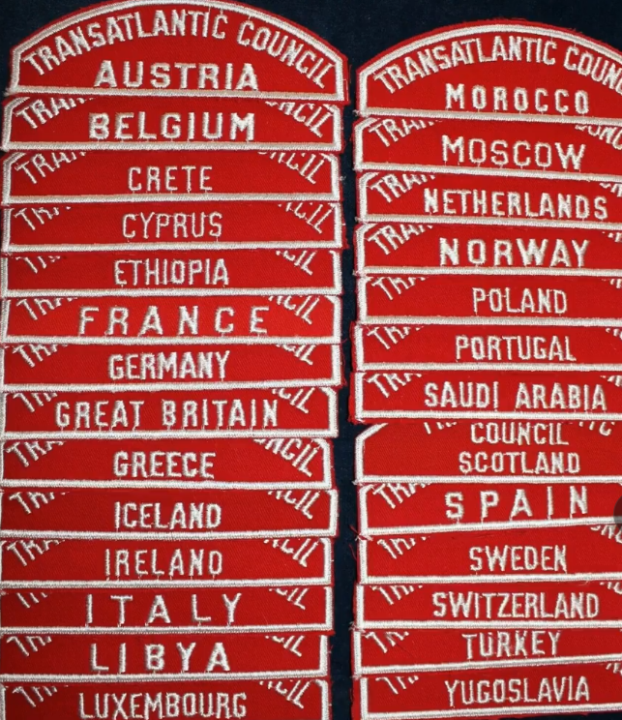
What is the positive impact of TAC Scouting?
4000+ youth developing their leadership and character
1500+ adults influencing youth of great promise
150+ units in 50 countries
Arrow of Light, Eagle Scout, Quartermaster, Summit Award recognitions
Day Camps, Summer Camps, Merit Badge Weekends, Camporees
Community Service Projects
Historic Trails
Notes:
What is the positive impact of TAC Scouting?
4000+ youth developing their leadership and character
1500+ adults influencing youth of great promise
150+ units in 50 countries
Arrow of Light, Eagle Scout, Quartermaster, Summit Award recognitions
Day Camps, Summer Camps, Merit Badge Weekends, Camporees
Community Service Projects
Historic Trails
And so much more!

Slide 7
TAC Eagle Scout Projects
Bike Park Reclamation
High School Gardens
Refugees on Wheels
Orphans Home Shoe Drive
Hands-on CPR Marathon
Toy Drive for Refugees
Refugee Center
Building Bat Houses
5K for Autism Awareness
Notes:
And we cannot overlook the positive impact of TAC Eagle Scout projects.
Here are some examples.
Bike Park Reclamation
High School Gardens
Refugees on Wheels
Orphans Home Shoe Drive
Hands-on CPR Marathon
Toy Drive for Refugees
Refugee Center
Building Bat Houses
5K for Autism Awareness
What other Eagle Scout projects have you experienced or heard about?

Slide 8
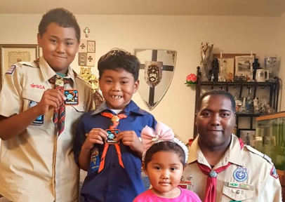
Why invest in TAC Scouting?
Unparalleled Scouting for more youth
Better camp programs
More trained volunteers
Stronger support to TAC Communities
More packs, troops, crews, ships
Develop leaders and citizens
Instill values of Scout Oath and Law
Notes:
So, why invest in TAC Scouting?
Why might that be important to extend your influence beyond the immediate Scouting community that you live in?
Unparalleled Scouting for more youth
Better camp programs
More trained volunteers
Stronger support to TAC Communities
More packs, troops, crews, ships
Develop leaders and citizens
Instill values of Scout Oath and Law

Slide 9
2023 FOS Goal--$300,000 ​
Goal is ambitious, but achievable. ​
High level of engagement from our board members is critical.​
Will require outreach beyond our current donors, i.e., NEW donors.​
Will require significant engagement from district leaders, especially regarding new donors and membership. ​
Notes:
Goal of $300,000​
Goal is ambitious, but achievable. ​
High level of engagement from our board members is critical.​
Will require outreach beyond our current donors, i.e., NEW donors.​
Will require significant engagement from district leaders, especially regarding new donors and membership

Slide 10
Paul Ostling Challenge Gifts​​
NEW Donors​
A dollar-for-dollar match up to $15,000 for all NEW FOS gifts received between 1 Dec 2022 and 28 Feb 2023​
Increased Membership​
$1000 gift for each district with 6% increase by 31 Dec 2022​
$2000 gift for each district with 8% increase by 31 Dec 2022​
$3000 gift for each district with 10% increase by 31 Dec 2022​
Notes:
Paul Ostling Challenge Gifts
NEW Donors​
A dollar-for-dollar match up to $15,000 for all NEW FOS gifts received between 1 Dec 2022 and 28 Feb 2023​
Increased Membership​
$1000 gift for each district with 6% increase by 31 Dec 2022​
$2000 gift for each district with 8% increase by 31 Dec 2022​
$3000 gift for each district with 10% increase by 31 Dec 2022​

Slide 11
FOS Giving Levels and Recognition​​
Notes:
FOS Giving Levels and Recognition
Volunteer Recognition – confirm 5 gifts​ (not including your own FOS gift)
$2000 ($200/month) – 8 Scouts Level​
$1000 ($100/month) – 4 Scouts Level​
$500 ($50/month) – 2 Scouts Level​
$250 ($25/month) – 1 Scouts Level​
$125 ($12.50/month) – “Scout Me In” Level​
If you give at a level higher than the “Scout Me In” level, you get the patch for that level and all the patches below that level.
For example, if you give at the 2 Scout Level, you get the 2 Scout Level patch, the 1 Scout Level patch, and the Scout Me In patch.

Slide 12
Notes:
Friends of Scouting (FOS) Volunteer Recognition.
Confirm 5 Friends of Scouting gifts (not including your own FOS gift)
From 1 December 2022 through 28 February 2023
And receive this Eagle patch for your recognition.

Slide 13
IC5 Structure

Slide 14
IC5 Leadership & Support​

Slide 15
I-C-5 means I "see" (C) 5 individuals and invite them to give to Friends of Scouting
Notes:
I-C-5 means that I-C-5 means I "see" (C) 5 individuals and invite them to give to Friends of Scouting.
So you want to recruit, train, and guide enough volunteers so that you have "teams of 5" being approached by a volunteer who will make their own Friends of Scouting gift and invite 5 others to give as well.
In this sample chart, pay attention to the following:
Volunteer captains names are in bold font—with the team of 5 volunteers they will approach for a Friends of Scouting gift
Track previous giving in Friends of Scouting and come up with a suggested ask for the 2023 Friends of Scouting appeal
When individuals make their gift, highlight their name in yellow
When all the individuals in one team have made their gift, highlight the entire team in green
Share this report with all your volunteer captains each week—to drive recognition, appreciation, and action

Slide 16
Friends of Scouting Training Sessions (Paris time)​ https://us02web.zoom.us/j/87897335122
Monday 7 November 2000 to 2130​
Tuesday 8 November 1700 to 1830​
Wednesday 9 November 1800 to 1930​
Thursday 10 November 1900 to 2030​
Goal of 100% attendance for all FOS Leaders ​
– Choose only one session​
Notes:
FOS Training Sessions​ https://us02web.zoom.us/j/87897335122
Friends of Scouting Training Sessions (Paris time)​
Monday 7 November 2000 to 2130​
Tuesday 8 November 1700 to 1830​
Wednesday 9 November 1800 to 1930​
Thursday 10 November 1900 to 2030​
Goal of 100% attendance for all FOS Leaders ​
– Choose only one session

Slide 17
FOS Weekly Report Meetings https://us02web.zoom.us/j/89936389806 ​
All IC5 Leaders are encouraged to attend.​
Wednesdays from 1700 to 1830 (Paris time)​
7 and 14 December​
4, 11, 18, 25 January 2023 ​
1, 8, 15, 22 February 2023 ​
1 March 2023—FOS Celebration​
5 April 2023—FOS Debrief and Evaluation​
Notes:
FOS Weekly Report Meetings
All IC5 Leaders are encouraged to attend.​
Wednesdays from 1700 to 1830 (Paris time)​
7 and 14 December​
4, 11, 18, 25 January 2023 ​
1, 8, 15, 22 February 2023 ​
1 March 2023—FOS Celebration​
5 April 2023—FOS Debrief and Evaluation​

Slide 18
Notes:
What are giving motivators for donors?
Confidence, Clarity, Value, Personal connection, Visible impact, Gratitude

Slide 19
Notes:
Here are some examples of Giving motivators

Slide 20
Direct FOS Invitation—Face to Face or Zoom or Phone Call ​
Notes:
The most effective way to invite a donor to give is a direct invitation:
Face to Face
Zoom
Phone call

Slide 21
Email FOS Invitation. Words Matter—when inviting donors to give
Notes:
Email FOS Invitation. Words Matter—when inviting donors to give.
CaringBridge was running a two-day match in the month of December as part of their year end campaign. They wondered if more “communal language” that affirmed the donor in their relationship to CaringBridge and made a less direct ask would be more effective at getting people to enter the donation funnel.
They drafted a treatment that made some key shifts.
First, it began by talking about the donor themselves—”You’ve been such a great friend by staying engaged through CaringBridge.
Then, it softened the ask by starting with “If it’s not too much to ask”, which gives the donor a sort of “release valve” from the pressure of “donate now”.
Finally, the matching gift from the Board of Directors was positioned as an opportunity or service offering provided to the donor rather than something they were expected to respond to.

Slide 22
5 Steps to an Effective FOS Invitation via Email
Introduce yourself
Explain how Scouting changed you
Tell what you learned in Scouting
Conclude that “Because of Scouting…”
Then share the invitation to give
Notes:
5 Steps to an Effective FOS Invitation via Email
Introduce yourself
Explain how Scouting changed you
Tell what you learned in Scouting
Conclude that “Because of Scouting…”
Then share the invitation to give

Slide 23
1. Introduce yourself
Jim, this is Dan Coberly, a National Representative for the Transatlantic Council, BSA. I'm writing to thank you for your support of TAC, and to tell you how important your contributions are to help keep American Scouting thriving overseas.
In the early 1960’s as a young preteen in the U.S. Panama Canal Zone, I’d reached the first fork in the road of my young life. I was being pressured to join a gang.
My father, like many others, was a Special Forces Soldier deployed on many far-away missions. He simply wasn’t there to guide me. My mother was a French-Italian WWII war bride, still learning to speak English. Life was chaos, without stability, moving around the world, always worried that my father would not come home.

Slide 24
2. Explain how Scouting changed you
That day, one of my friends invited me to join what he called a “good gang”—the Boy Scouts of America. I went to my first meeting and I was hooked. Suddenly, I belonged to something. There was a plan, a structure, fun and fellowship, standards that were completely up to me to meet. And there many unselfish leaders who became my role models.
Scouting brought a touch of America to us living overseas. That was important because I hardly lived in the States. Scouting was the one constant in my life, no matter where we lived throughout the world. Unlike sports or clubs or other activities, in Scouting, I didn't have to start over whenever we moved; I could continue on the trail to Eagle. I and had friends, instantly!

Slide 25
3. Tell what you learned in Scouting
What I learned in Scouting about myself and other people is more valuable than all the degrees I have since earned. The self-confidence and life-long skills I gained as an Eagle Scout in Troop 62, Wurzburg, Germany, is what every young person needs to be prepared to make intelligent choices in life. Learning how to be a good leader, but also how to be a good follower made all the difference in three successful careers as a journalist, author, and strategic communicator. Since then, I’ve been blessed to meet and to work with many famous leaders, Kings and Queens and Astronauts; senior cabinet level officials, Supreme Allied Commanders…all of whom were Scouts.

Slide 26
4. Conclude that “Because of Scouting…”
Because of Scouting, I attained the highest enlisted rank in the military, completed many college degrees, was directly commissioned as an officer, became a Distinguished Eagle Scout (back in TAC), was inducted in the US Army Public Affairs Hall of fame, and earned many awards for distinguished leadership and community service.
Thank God that because of people like you, Scouting offered me a choice that day, and every day, when I reach a fork in the road. It could have been a much different story.

Slide 27
5. Then share the invitation to give
That's why I'm writing you to please donate whatever you can to our Friends of Scouting Campaign. I assure you that you'll make a vital difference for a boy or girl who needs it most!
Please use this link to donate now:
https://tac-bsa.org/donate/fos/
And feel free to call or write me if you have any questions.
THANK YOU on behalf of all TAC Scouts and Scouters!
Dan Coberly

Slide 28
Email. Use your donor’s first name
Notes:
Email. Use your donor’s first name.
The quickest way to let your donor know that you don’t actually know them is by starting your email with “Dear friend.”
Nearly every email tool on the market today allows you to insert the recipients first name. And as it turns out, when we call our donors by name, our email performance improves. In experiment 5707, this organization wondered if they could improve their email response by calling the donor by their first name.
Personalizing the email by calling the donor by their name led to a 270% increase in clicks.

Slide 29
Email. Personalize your fundraising emails
Notes:
Email. Personalization is more than just inserting a first name here and there.
It’s about making the entire email feel personal to the recipient – as if you sat down and wrote an email specifically to them.
This includes personal sender names, subject lines, and copy.
In experiment 4307, this organization wondered if they could increase email results by making the whole email feel more personal.
Making the email feel more personal led to a 137% increase in clicks.

Slide 30
WhatsApp Invitation to Give
Mary,
We are part of the BSA Transatlantic Council (TAC). We need your help, please, to ensure a strong TAC Scouting program for 2023.
We all need to support TAC’s annual Friends of Scouting fundraising campaign, which ends on 28 February.
TAC spends around $250 per year on average to support each Scout, but receives only $48 per Scout at registration. We shouldn’t make TAC raise funds from other families to support our own Scouts. We each need to support all of our own Scouts – and as many additional Scouts as possible so that TAC can afford to serve less-fortunate families.
Please take 3 minutes now to invest in TAC Scouting here:
https://tac-bsa.org/donate/fos/
Notes:
WhatsApp Invitation to Give
Mary,
We are part of the BSA Transatlantic Council (TAC). We need your help, please, to ensure a strong TAC Scouting program for 2023.
We all need to support TAC’s annual Friends of Scouting fundraising campaign, which ends on 28 February.
TAC spends around $250 per year on average to support each Scout, but receives only $48 per Scout at registration.
We shouldn’t make TAC raise funds from other families to support our own Scouts. We each need to support all of our own Scouts – and as many additional Scouts as possible so that TAC can afford to serve less-fortunate families.
Please take 3 minutes now to invest in TAC Scouting here:
https://tac-bsa.org/donate/fos/

Slide 31
Notes:
So as you get the district, executive board, or TAC alumni ready to be approached for a Friends of Scouting gift, who can help you in this effort?
Scouters that you can reach out to include:
Friends of Scouting donors (current and former)
Wood Badge staffers and participants
Silver Beaver, Award of Merit, and TAC Patch recipients
Experienced unit volunteers
Eagle Scouts of all ages
TAC Alumni
Executive Board and Council Committee members
District Committees and Commissioners
Who else do you know—that you feel comfortable inviting to help you in Friends of Scouting?

Slide 32
...because of your Friends of Scouting gift, you (and others) get "Unparalleled Scouting”
Scout recognition with free pinewood derby cars or Scout sporks
Scouts needing help can request and receive camperships
Klondike, Normandy Camporee, Camp Avantura BSA,
Camp Alpine, Camp Kenya
Scout-a-thon—all profits stay with units and free prizes for Scouts
Registered Volunteers have strong liability insurance protection
TAC Connection e-newsletter and TAC social media
TAC Staff help daily with answers, solutions, help, advancement, program, recruitment, camps, and much more
Notes:
And as you get ready to communicate your key messages about Friends of Scouting, here is a powerful approach.
Just say that "...because of your Friends of Scouting gift, you (and others) get Unparalleled Scouting.
Your gift makes these things possible:
Scout recognition with free pinewood derby cars or Scout sporks
Scouts needing help can request and receive camperships
Klondike, Normandy Camporee, Camp Avantura BSA,
Camp Alpine, Camp Kenya
Scout-a-thon—all profits stay with units and free prizes for Scouts
Registered Volunteers have strong liability insurance protection
TAC Connection e-newsletter and TAC social media
TAC Staff help daily with answers, solutions, help, advancement, program, recruitment, camps, and much more

Slide 33
2023 Budget of $1.9 million
Program 90.37%
Administration 6.56%
Fundraising 3.07%
Notes:
The 2023 budget of $1.9 million is heavily focused on program (90.37%)--with modest investments in administration (6.56%) and fundraising (3.07%).
These percentages come from a time study that the TAC staff does to determine how they spend their time—and most of that time is spent on delivering programs and services to our TAC communities and volunteers.

Slide 34
Friends of Scouting provides about 15% of TAC income

Slide 35
How TAC Spends its Funds
People—Salaries and Travel
8 Full Time Staff in Belgium, Netherlands, Germany, Pennsylvania
Many Seasonal Scout Camp Staff in Switzerland, Croatia, Kenya
Stuff—Programs and Services
Insurance (Accident/Sickness and Liability), COVID-19 Precautions, Safe Scouting
Patches, Program Supply, Recognitions, Training, Conferences, Roundtables
TAC Connection, Website, Social Media, New Unit Organization, Scout Recruitment
Notes:
Another way to look at how TAC spends the funds it raises in Friends of Scouting.
We spend funds on people and on stuff.
People—Salaries and Travel
8 Full Time Staff in Belgium, Netherlands, Germany, Pennsylvania
Many Seasonal Scout Camp Staff in Switzerland, Croatia, Kenya
Stuff—Programs and Services
Insurance (Accident/Sickness and Liability), COVID-19 Precautions, Safe Scouting
Patches, Program Supply, Recognitions, Training, Conferences, Roundtables
TAC Connection, Website, Social Media, New Unit Organization, Scout Recruitment

Slide 36
https://tac-bsa.org/donate/fos/
Notes:
So how do you make your gift to Friends of Scouting?
Where do you direct your volunteers to make their Friends of Scouting gift?
Go to the TAC webpage https://tac-bsa.org/donate/fos/
This is where we keep all the information needed to understand the Friends of Scouting program.
After reviewing all the resources, click the “Give Now!” button

Slide 37
Friends of Scouting online giving portal
Notes:
...and you will arrive at this page where the Friends of Scouting online giving portal is located.
This year, we just have one FOS appeal.

Slide 38
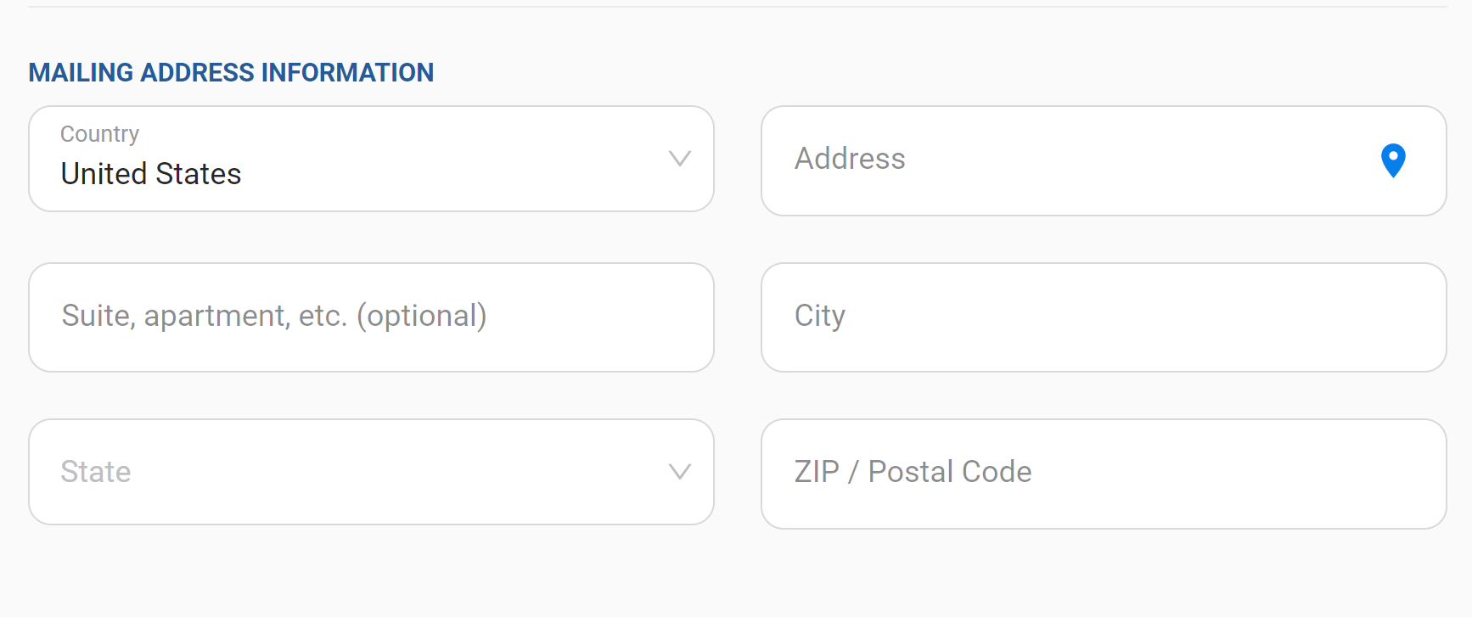
Information—Personal, Additional, Employer Match, Mailing Address
Notes:
It will first ask you for personal information and additional information.
You can also list your district and your unit if you would like.
And list any employer gift match information if you can. If this feature does not work for you, please encourage your donors to reach out to the TAC staff for help.
TAC receives many funds each year in matching gifts—and we are very delighted to receive more.
You will also add your mailing address.

Slide 39
FOS Gift--$1000 One-time
Notes:
Then indicate the gift that you would like to make.
Here is an example of a one-time gift of $1,000.
Select $1,000
Select One-time

Slide 40
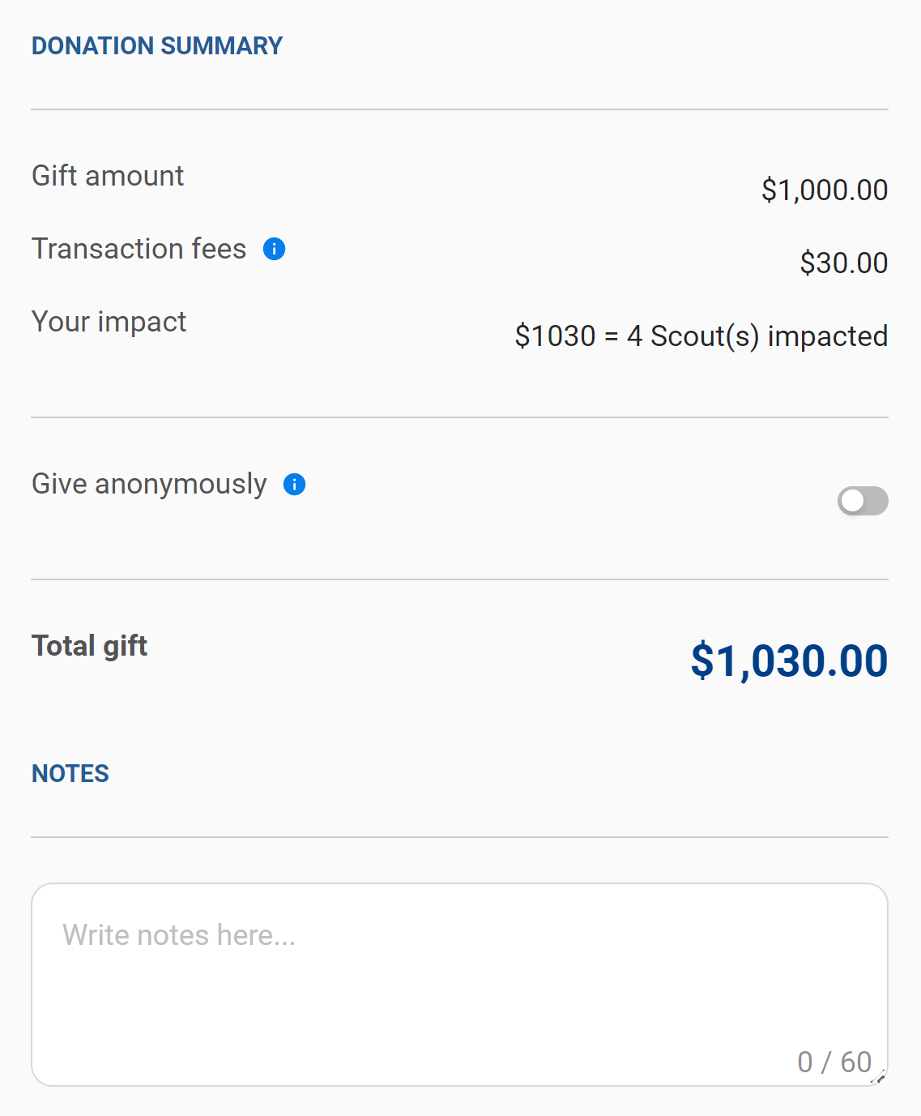
FOS Gift--$1000 One-time
Notes:
Then indicate your credit card information. We accept VISA, MasterCard, American Express, or Discover.
Be sure that your billing address is the same as address above—or uncheck that box and type in the billing address for your credit card.
Note that you can check the box: Maximize my gift’s impact and pay transaction fees.
In this example, the total gift will be $1,030 because the donor has chosen to pay the credit card transaction fees.
You will see at the bottom a Donation Summary that confirms your overall gift of $1,030. You can also type in brief notes if you’d like,
You could also pay by e-check off a US bank or make a pledge and ask that you be reminded on when to pay later.
Remember that we are trying to reach our overall Friends of Scouting goal by the end of February. In many cases, pledges to be paid after 28 February are ok. And monthly giving that will include payments made past the 28 February date is ok too.

Slide 41
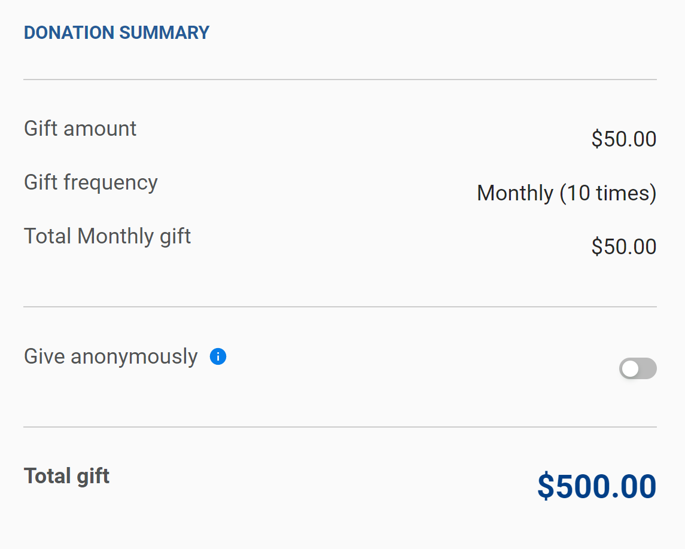
FOS Gift--$500 ($50 monthly over 10 months)
Notes:
Here is another example of a gift of $500 that is going to be made by giving $50 over 10 months.
Click the Monthly tab--so that a payment will be charged each month on your credit card.
Select 10 (where you indicate how many months you want your payment of $50 to be made)
Select Other and type in 50, which is the $$ you want to give each month, not your total gift!
Be sure to not type in any $$ signs. Just type in the number.
In this example, the donor choose NOT to pay the credit card transaction fees.
You will see at the bottom a Donation Summary that confirms an overall gift of $500.

Slide 42
Be sure to check the box and hit “Give Now” button
Notes:
To process your gift, check the box at the bottom and select the "Give Now" button.

Slide 43
FOS Resources www.tac-bsa.org/donate/fos
Notes:
There are Friends of Scouting resources on the TAC website to help you. This FOS presentation is also available on this website.
www.tac-bsa.org/donate/fos
Friends of Scouting Resources
Friends of Scouting Questions and Answers
Friends of Scouting Email to Executive Board and Advisory Council Members
Friends of Scouting Asks to Volunteers and Parents
FOS Volunteer Training.ppt
FOS Volunteer Training.pdf
TAC Highlights 2020
TAC Highlights 2021
Friends of Scouting Promotional Video

